Slide 1
Lesson 5
Tā nǚ ér jīn nián 20 suì.
Her daughter is 20 years old this year.

Slide 2
New words
Jiā family, home
Yǒu have , there be
Jǐ how many
Kǒu a measure word for family members
Suì year of age
nǚ ér daughter
jīn nián this year
Le it marks an action as complete
Duō many , much(indicate degree or extent)
Dà big (age : how old of age)

Slide 3
TEXT 1 In the school
A: Nǐ jiā yǒu jǐ kǒu rén?
B: Wǒ jiā yǒu sān kǒu rén.
Family
Have,
there be
How many
A measure word for family members

Slide 4
Practice
A: Nǐ jiā yǒu jǐ kǒu rén?
B: Wǒ jiā yǒu ___ kǒu rén.

Slide 5
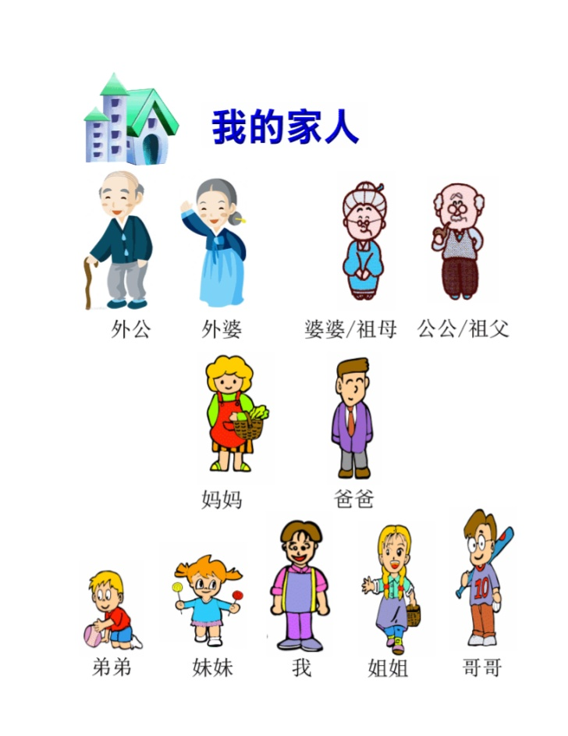
Family member
Family member
wài gōng
wài pó
nǎi nai
yé ye
mā ma
bà ba
dì di
mèi mei
wǒ
jiě jie
gē ge

Slide 6
Introduce Your Family Members
Example:
Wǒ jiā yǒu sì kǒu rén.
Wǒ yǒu :bàba, māma , yī gè jiějie.
Wǒ jiā yǒu ____kǒu rén.
Wǒ yǒu：___gè____, ___gè____... …

Slide 7
Ways of Asking a Chinese Person’s Age
In traditional Chinese culture, age is isn’t considered privacy. It is a topic often brought up in social occasions. Nevertheless, different ways are employed to ask about the age of different people.
For kids younger than 10,peole ask:
Nǐ jīn nián jǐ suì le ?
For a young person or someone of one’s own age:
Nǐ jīn nián duō dà le ?
For an elder person to show respect:
Nín jīn nián duō dà nián jì le?

Slide 8
TEXT 2 In the office
A: Nǐ nǚ ér jǐ suì le?
B: Tā jīn nián sì suì le.
daughter
year of age
Action complete mark
This year

Slide 9
Text 3 In the office
A: Lǐ lǎoshī duō dà le ?
B: Tā jīn nián 50 suì le.
A: Tā nǚ ér ne?
B: Tā nǚ ér jīn nián 20 suì.
How old

Slide 10
Ways of Asking a Chinese Person’s Age
For kids younger than 10,peole ask:
For a young person or someone of one’s own age:
For an elder person to show respect:
Nǐ jīn nián jǐ suì le ?
Nǐ jīn nián duō dà le ?
Nín jīn nián duō dà nián jì le?

Slide 11
11-99
11 = 10 + 1
12 = 10 + 2
13 = 10 + 3
14 = 10 + 4
15 = 10 + 5
16 = 10 + 6
17 = 10 + 7
18 = 10 + 8
19 = 10 + 9

Slide 12
20 = ?
20 = 10 + 10 ? X
20 = 2 x 10
21 = 20 + 1
2 x 10 + 1
22 = 20 + 2
2 x 10 + 2

